Slide 1

Girl Develop It!
Introduction to
User Experience
06/07/2021

Slide 2
Welcome!

Slide 3
Please place an optional introductory in the chat!
Preferred name and pronouns
Where you’re based/located
What brings you here

Slide 4
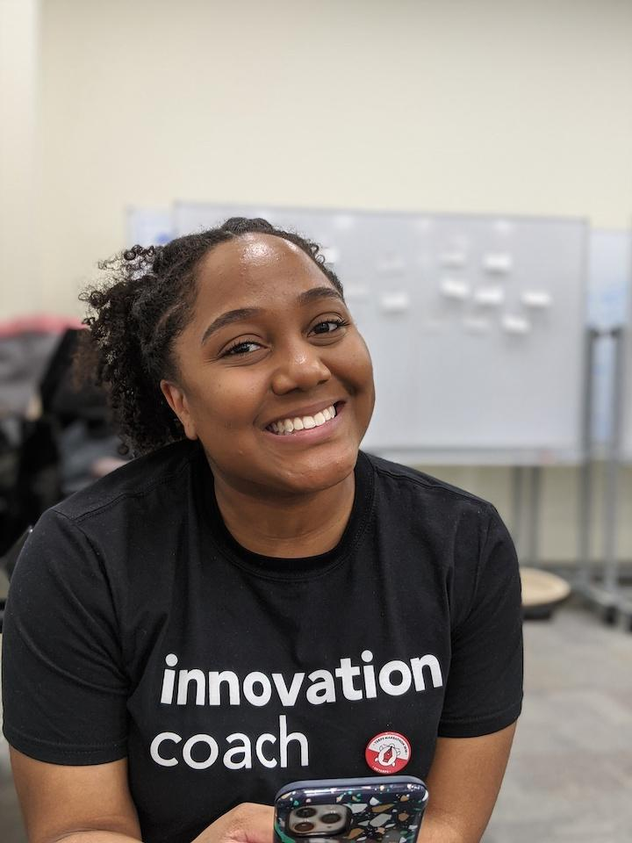
MEET YOUR INSTRUCTOR
LaRia Rogers (She/Her)
Designer, Researcher and Educator based in Maryland

Slide 5
01
04
02
05*
TODAY’S AGENDA
03
Foundation
Resources
Process
Cohort Kickoff
Careers

Slide 6
01
FOUNDATION
An overview of User Experience

Slide 7
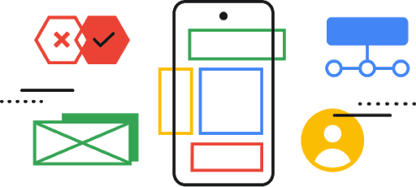
01 - FOUNDATION
What is User Experience?
In the Chat: Using 5 words or less, describe your definition of User Experience.

Slide 8
01 - FOUNDATION
“User Experience encompasses all aspects of the end-user’s interactions with the company, its services and its products.”
—Nielsen Norman

Slide 9
01 - FOUNDATION
“The experience the product creates for the people who use it in the real world.”
—Jesse James Garrett

Slide 10
01 - FOUNDATION
“Seamless, easy and memorable interaction of how a user gets from point A to point B.”
—LaRia Rogers (ME!)

Slide 11
01 - FOUNDATION
UX≠UI

Slide 12
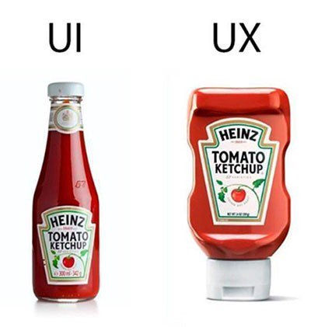
01 - FOUNDATION

Slide 13
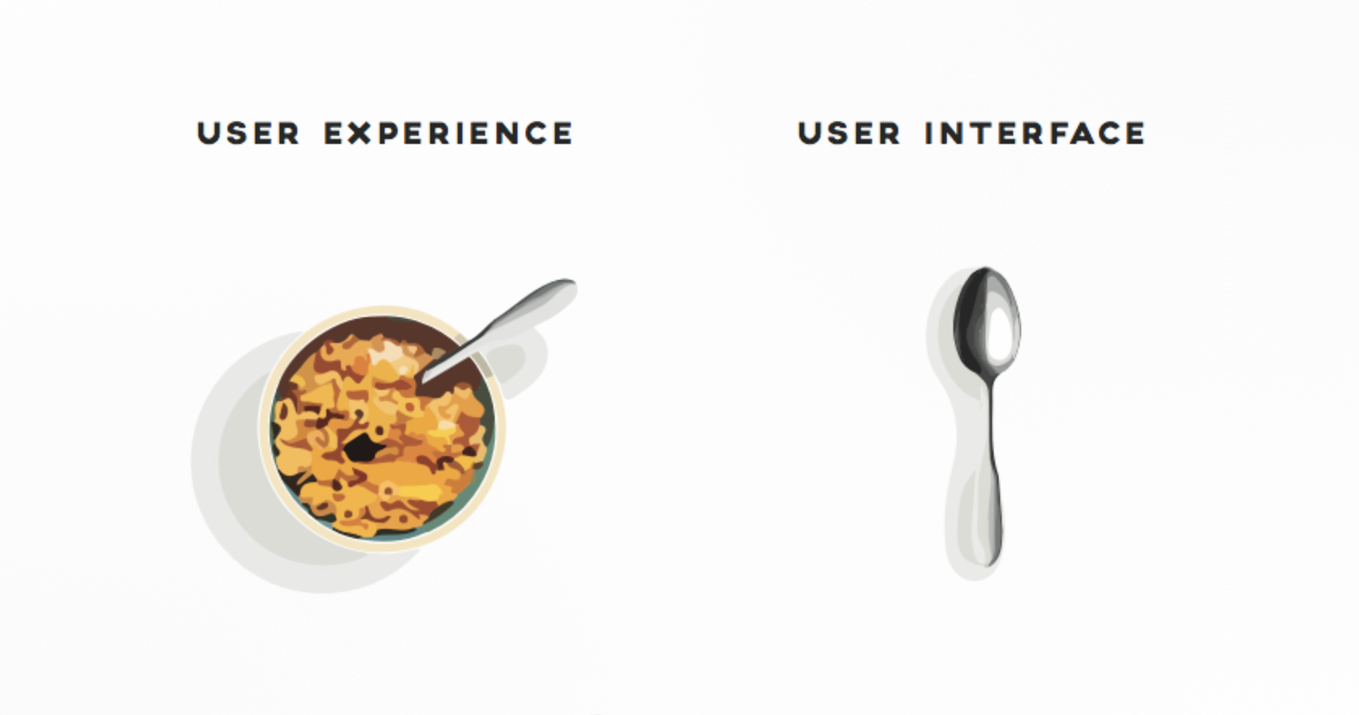
01 - FOUNDATION
Illustration by Shane Rounce

Slide 14
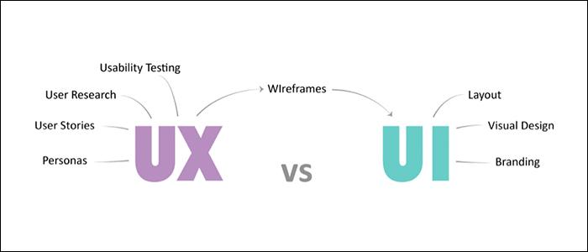
01 - FOUNDATION
Source

Slide 15

01 - FOUNDATION
Source
Notes:
Jesse Garrett created the 5 planes (or elements). Overtime people have adapted them into different visuals such as the UX iceberg shown here.

Slide 16
01 - FOUNDATION
What is good design?
In the Chat: Describe a time you had a good experience. This doesn’t have to be a web or mobile app example!

Slide 17
01 - FOUNDATION
Inclusive
Accessible
Navigation
Communicate
The needs of people with disabilities are specifically considered
Accessible to and usable by as many people as possible
Clear user flow and structure
Communicate content as effectively as possible
Emotion
Aesthetics
Consistent
Functional
Visual attractiveness
“Delightful” leads to recommendation
Consistency in element (macro vs micro)
Does what’s intended/promised

Slide 18
01 - FOUNDATION
What is poor design?
Information overload
Ambiguous navigation
Usability restrictions
Overly complicated

Slide 19
02
PROCESS
Stages and methods of User Experience

Slide 20
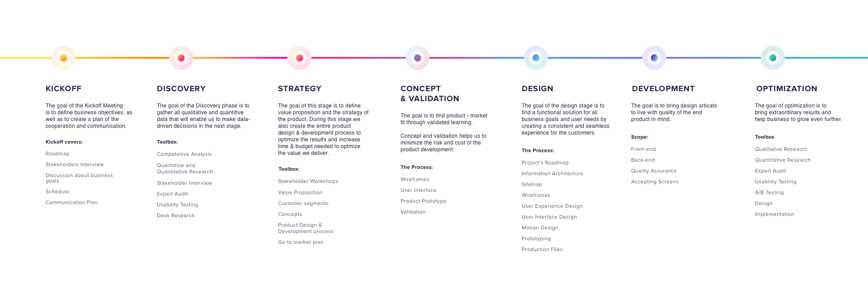
01 - FOUNDATION
Source

Slide 21
01 - FOUNDATION
Source

Slide 22
01 - FOUNDATION
Kickoff - Stakeholder Interview
Who: Those who have a stake in the success of your research and end result
What: A natural conversation - you should be able to respond to questions/comments and concerns about your research; be prepared!
When: Keep them informed and communicate early and often
Why: Set clear expectations of work; everyone on the same page of deliverables

Slide 23
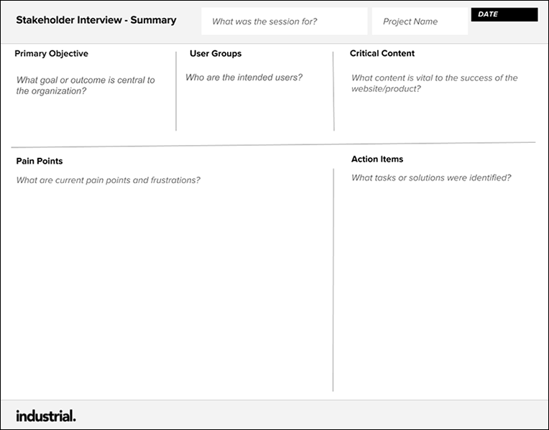
01 - FOUNDATION
Kickoff - Stakeholder Interview
How: Define goals
Project requirements
Scope documentation
Budgeting
Benefits: Provide “lay of the land”
Previous research/knowledge base
Understand users’ pain points
What’s worked well in the past/not so well

Slide 24
01 - FOUNDATION
Discovery - Competitive Analysis
Understand your goals - what do you hope to achieve and how will this research impact your UX decisions?
Types:
Direct competitor: companies doing what you do already - share the same customers and offer the same products
Indirect competitor: companies offer something similar to what you do; possibly their second or “third main product”

Slide 25
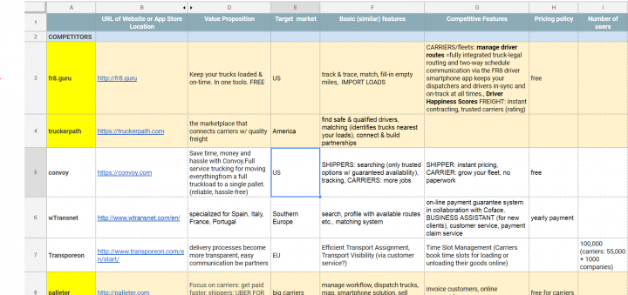
01 - FOUNDATION
Discovery - Competitive Analysis
How: List 3-5 brands (direct and/or indirect)
Scope functionality of brand and/or website/app/product
Examples:
Blog
Advance check-out
Filter/sort capabilities
Reviews and specifications
Rewards system

Slide 26
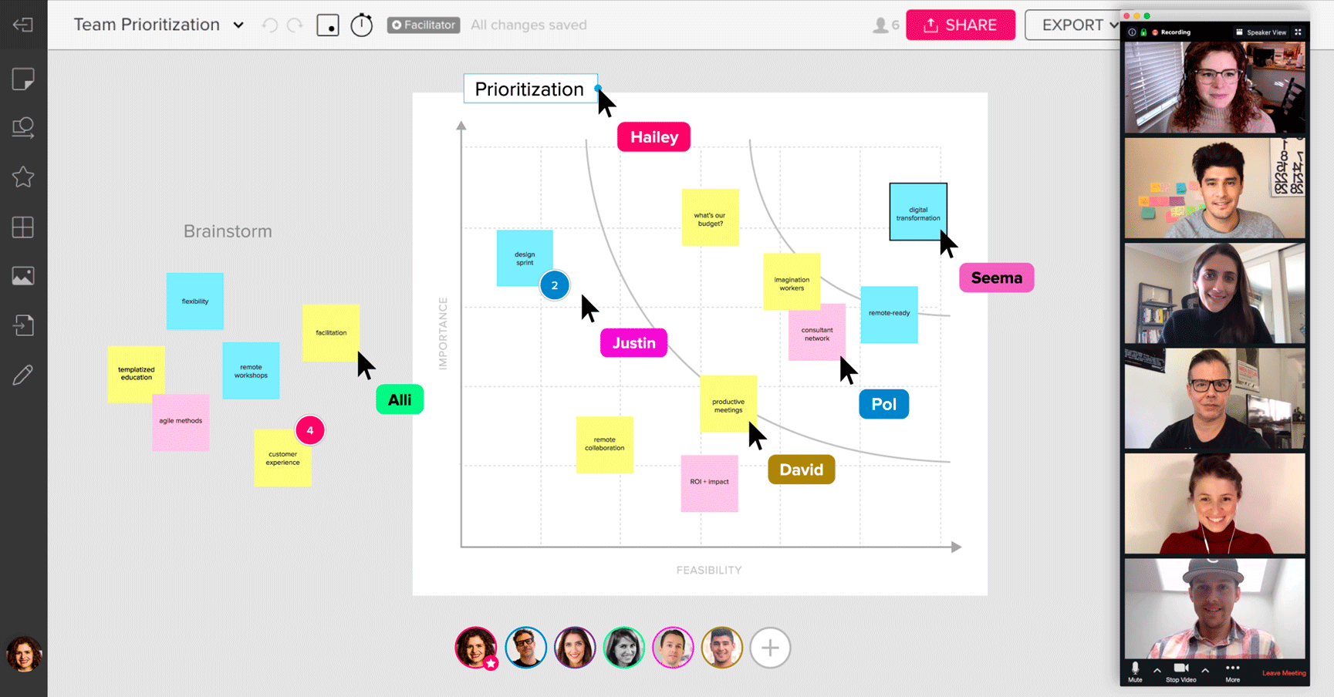
01 - FOUNDATION
Strategy - Stakeholder Workshops
Align on vision and goals and receive stakeholder buy-in and align
Examples:
Discovery workshop
Empathy workshop
Prioritization workshop

Slide 27
01 - FOUNDATION
Concept & Validation - Wireframes
Iterative process to visualize what a website/app/product will look like
Benefit: Provide fast feedback and validation from users, stakeholders, developers and designers

Slide 28
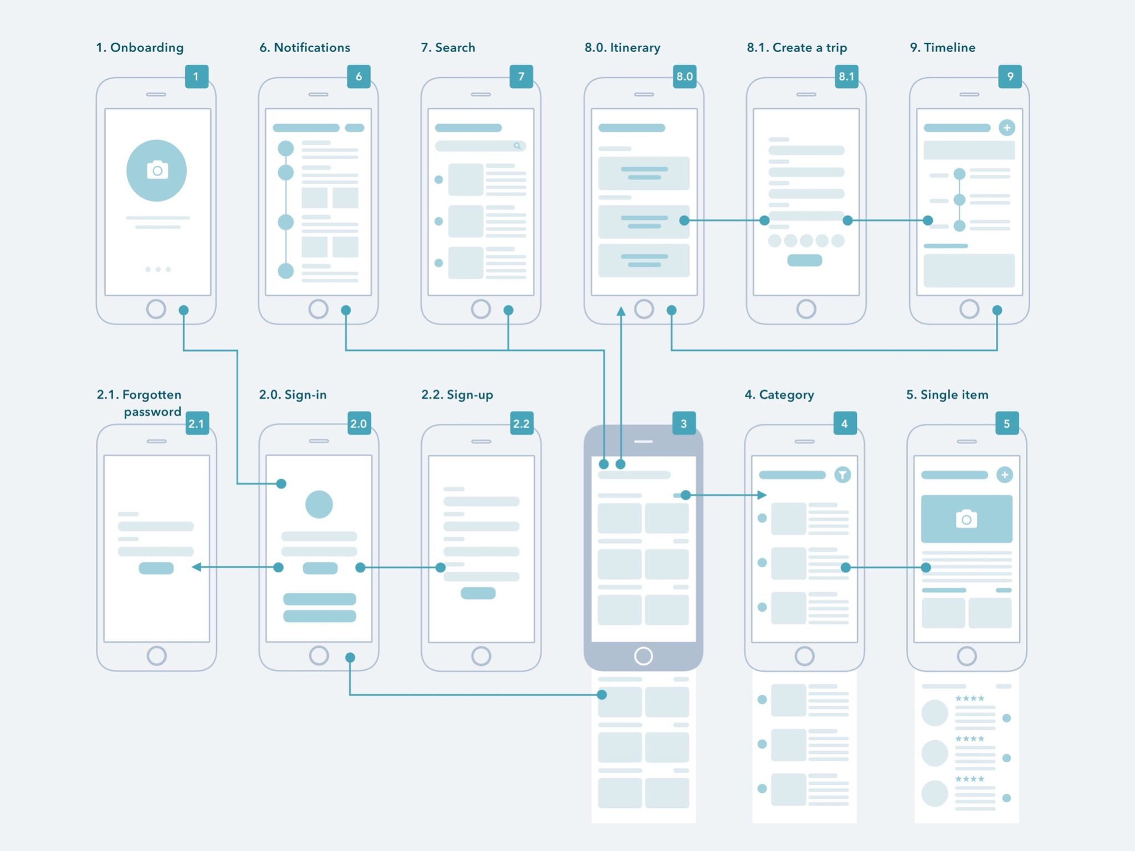
01 - FOUNDATION
Concept & Validation - Wireframes
How:
Prototype - create visual mockup of solution
Review - share with users to obtain feedback if prototype meets their needs and expectations
Refine - based on feedback, identify areas of improvement

Slide 29
01 - FOUNDATION
Design - Prototyping
Realistic interactivity; often looks like the “live” software to users.
Benefit: Faster system responses during testing, less pressure on the “computer” and ability to test specific UI components in addition to UX

Slide 30
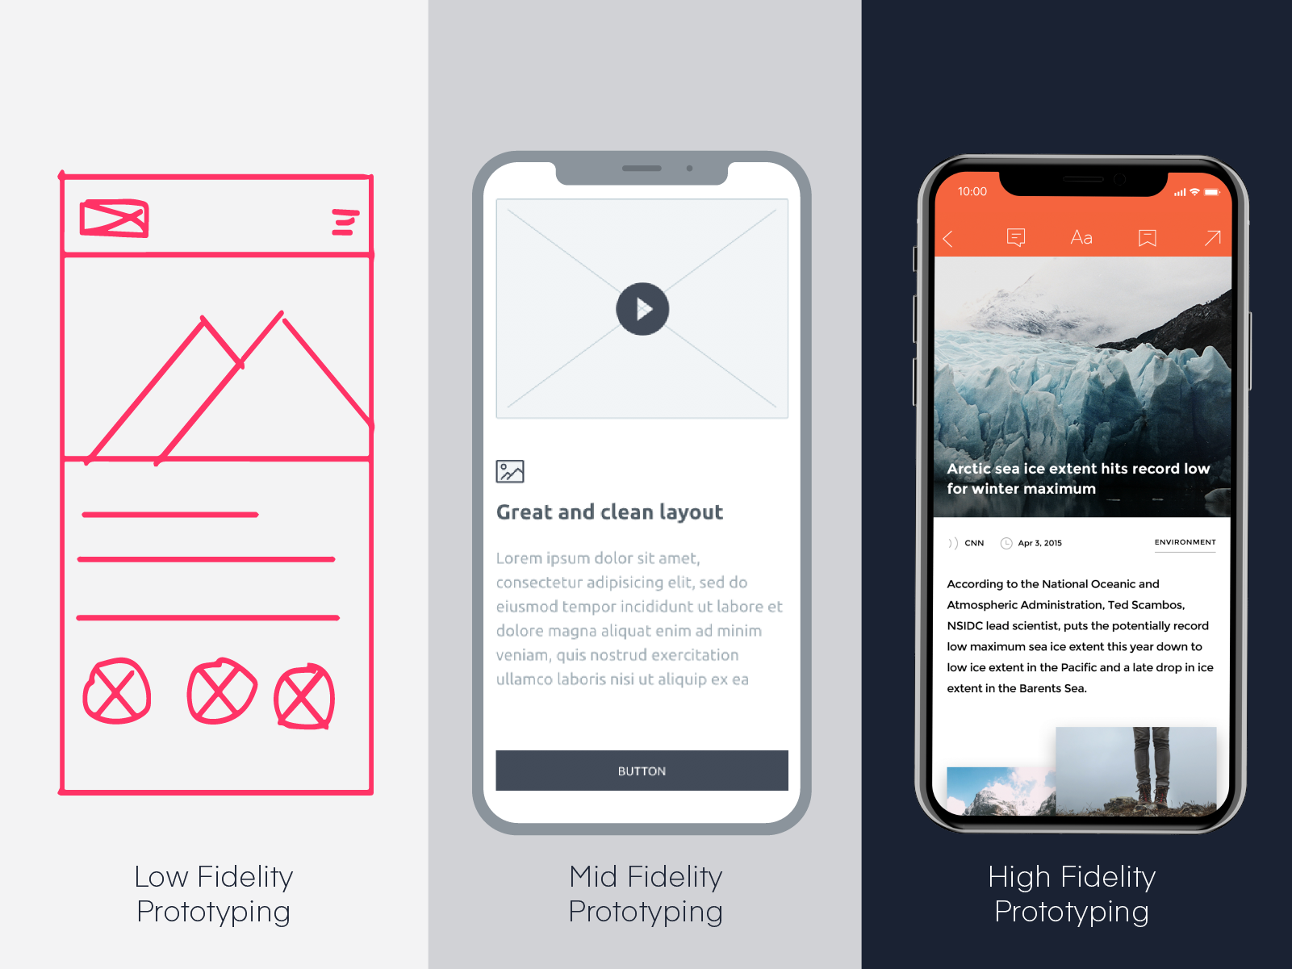
01 - FOUNDATION
Design - Prototyping
Source

Slide 31
03
CAREERS
Breadth and depth of UX roles

Slide 32
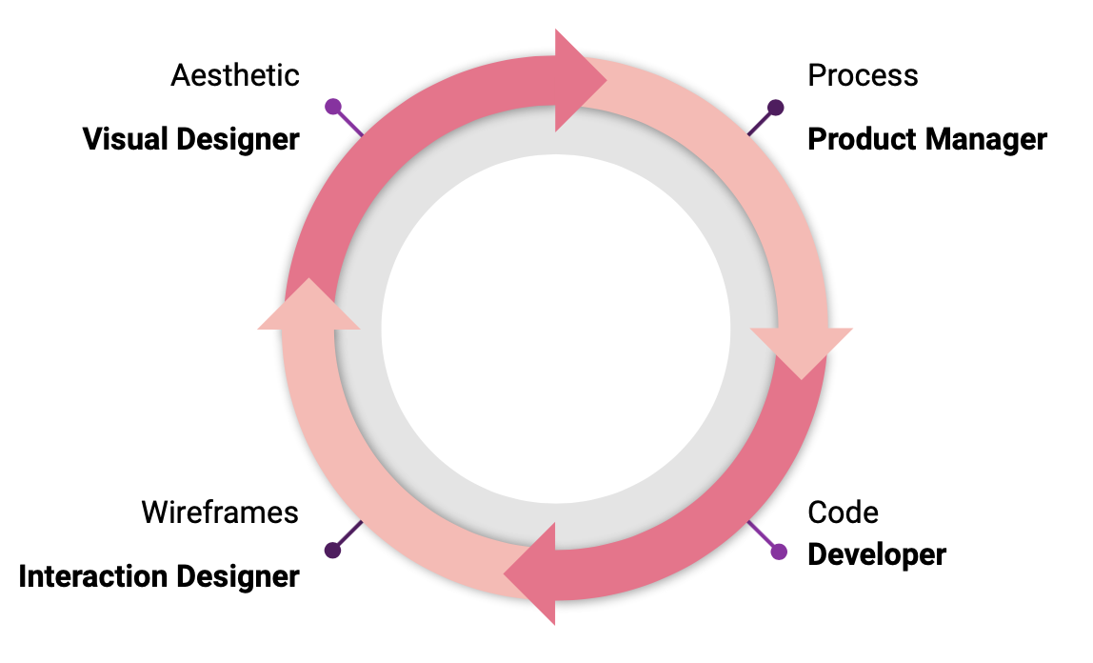
01 - FOUNDATION
Meet the team

Slide 33
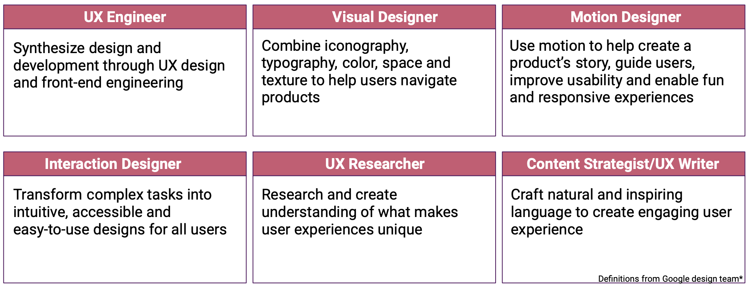
01 - FOUNDATION
UX roles & responsibilities

Slide 34
01 - FOUNDATION
Who’s hiring for UX?
Consulting - IBM, Deloitte, KPMG, Accenture
Tech - Facebook, Amazon, Netflix, Google
Social media - Instagram, Twitter
Communication - Dropbox, Slack
Retail - Nike, Target, Nordstrom
Finance - Capital One, JPMorgan
Government - 18F, Fearless

Slide 35
“The average UX designer in 2021 makes $85,000 USD.”
—Career Foundry

Slide 36
04
RESOURCES
Learning resources

Slide 37
01 - FOUNDATION
Designer tools
Wireframe
Prototype
Presentation
MockFlow
Balsamiq
Axure
Sketch
InVision
AdobeXD
Figma
Keynote
MS PowerPoint
Visual
Communication
Testing
Photoshop
Illustrator
Slack
Dropbox
Basecamp
Trello
UserZoom
UserTesting

Slide 38
01 - FOUNDATION
Resources
Websites:
Design Principles
InVision
Books:
Change by Design
Universal Methods of Design
The Laws of Simplicity
The Elements of UX
The Design of Everyday Things
Conferences:
Library of conference talks
All Design Conferences
Inspiration:
Dribble
Awwwards
Resources:
Noun Project
UI Goodies
UX Frameworks
Tutorials:
Dansky
Sketch Together
Flux
The Futur
Blogs:
Smashing Magazine
A List Apart
UX Collective
Nielsen Norman Group

Slide 39
05
COHORT KICKOFF
Looking ahead

Slide 40
GDI’s Inaugural UX Cohort!

Slide 41

What’s next?!
Introduction to User Research
Wednesday 06/09/21

Slide 42
Thank You!
Do you have any questions? Wanna keep in touch?
rogerslaria@gmail.com

